Slide 1
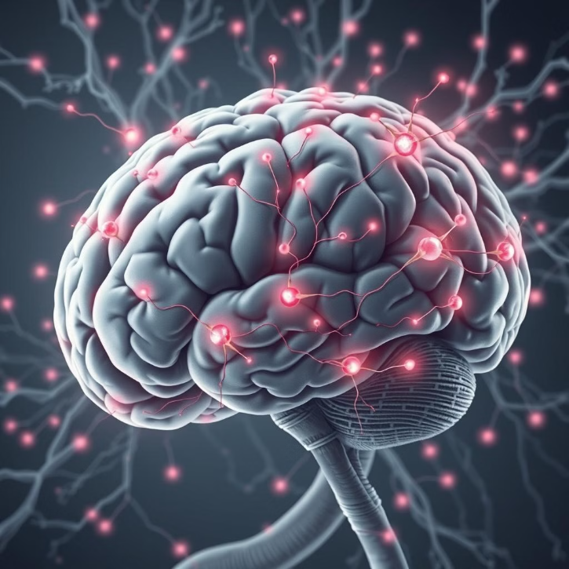
Generative AI for Early Detection and Personalized Management of Neurodegenerative Diseases
This platform aims to leverage the power of generative AI, real-time monitoring, and personalized therapy to enable early detection and proactive management of neurodegenerative diseases. By combining cutting-edge technologies, it strives to improve quality of life for patients and support caregivers.

Slide 2
Generative AI Models
Natural Language Processing
Image Generation
Speech and Facial Analysis
DALL-E and Stable Diffusion would be used to create personalized visual aids, cognitive therapy materials, and memory-supportive imagery tailored to patient history.
GPT and BERT are fine-tuned on neurodegenerative speech datasets to ensure precise, disease-specific interventions.
Deep Speech, Open Face, and Affective detect early signs of cognitive decline through speech patterns and micro-expressions with real-time monitoring, detecting micro-expressions linked to early symptoms of neurodegenerative diseases like Alzheimer's or Parkinson's.

Slide 3
Biometric and Voice Integration
1
Voice Diagnose
We ask specific questions to guide the user's response, record their voice using the platform’s microphone access, and analyze the audio with speech-to-text tools for further assessment.
2
Facial Diagnose
While recording the user's voice, simultaneously capture facial expressions using the platform’s camera, and analyze the video with facial recognition tools to diagnose any relevant expressions or micro-expressions.
3
Genetic Risk Analysis
Leverage bioinformatics tools like CRISPR libraries and AI bioinformatics tools (as TensorFlow and different Deep learning models for Genomics) to generate comprehensive risk profiles from genetic data.

Slide 4
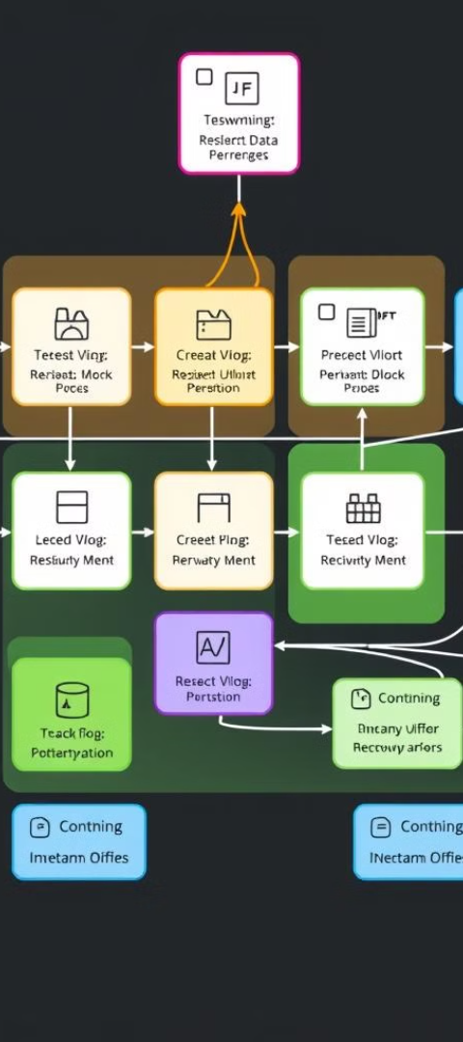
Backend Architecture
API Frameworks
Database Solutions
Django, Flask, and Node.js power the RESTful APIs to interact with AI models and manage data processing.
Use SQL (PostgreSQL, MySQL) for structured patient data and NoSQL (MongoDB) for unstructured speech, biometric, and memory records.
Cloud Deployment
Security and Compliance
Leverage AWS, Google Cloud, or Azure to host the platform's infrastructure, AI models, and databases mainly the use of AWS SageMaker.
Ensure end-to-end data encryption and compliance with regulations like HIPAA and GDPR.

Slide 5
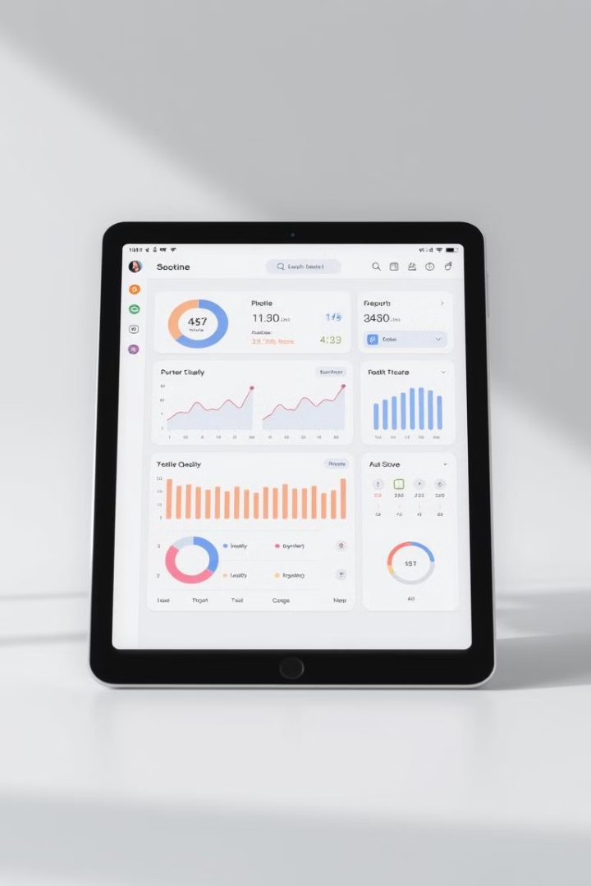



Frontends and Interactions
Web App
React.js and tailwind for dynamic, responsive interfaces for patients and healthcare providers.
Mobile App
React Native or Flutter for cross-platform mobile applications to track patient activity and communicate with caregivers.
Voice Interactions
Google Cloud Speech-to-Text and Dialog flow for voice-based patient engagement and early symptom detection.

Slide 6

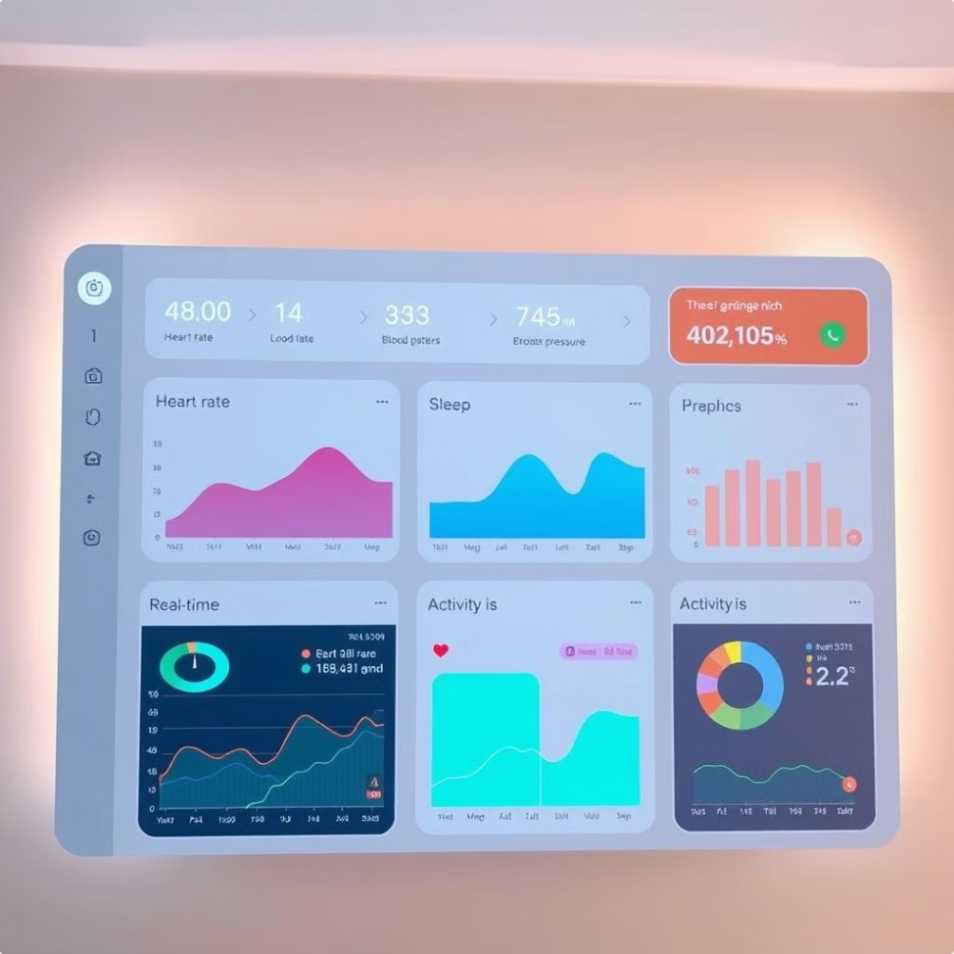
Real-Time Monitoring and Analytics
1
Predictive Modeling
Use time series analysis and tools like Prophet to predict motor deterioration and cognitive decline from continuous data inputs.
2
Visualization
D3.js and Chart.js provide intuitive visualizations of disease progression, therapy adherence, and medication effectiveness.
3
Real-Time Alerts
Firebase and One Signal push notifications keep caregivers informed of critical health events and changes.

Slide 7

Emotion and Memory Support
1
Emotion Analysis
Use of APIs like Microsoft Azure Emotion API to continuously assess the patient's emotional state and adjust conversational agents accordingly
2
Memory Rebuilding
GPT-based natural language generation creates personalized memory books and narrative recall for Alzheimer's patients.
3
Caregiver Collaboration
The React Admin-powered caregiver dashboard enables real-time monitoring, routine management, and personalized care plans.

Slide 8
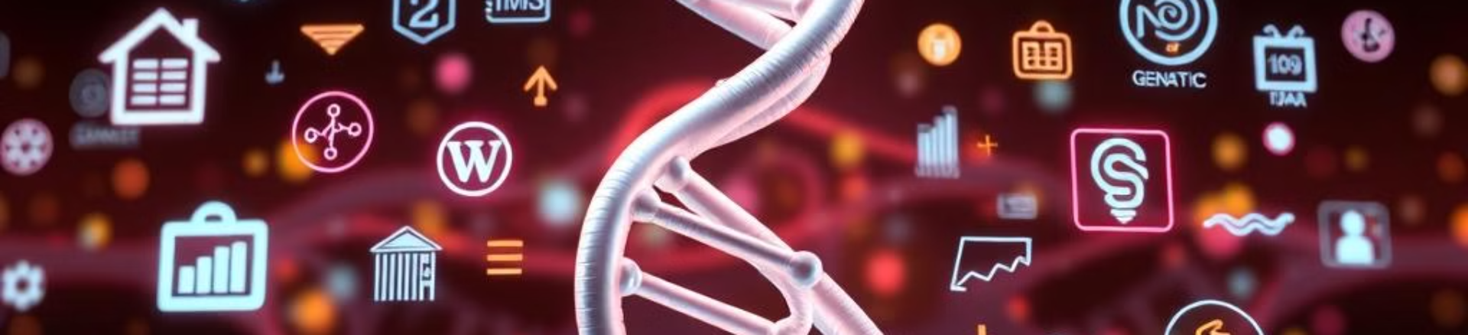
Genetic Risk and Profiling
Genetic Risk Factors
Predictive Biomarkers
Early Intervention Strategies
APOE, GBA, LRRK2 mutations
Protein aggregation, inflammation, oxidative stress
Lifestyle modifications, targeted therapies, clinical improvements

Slide 9
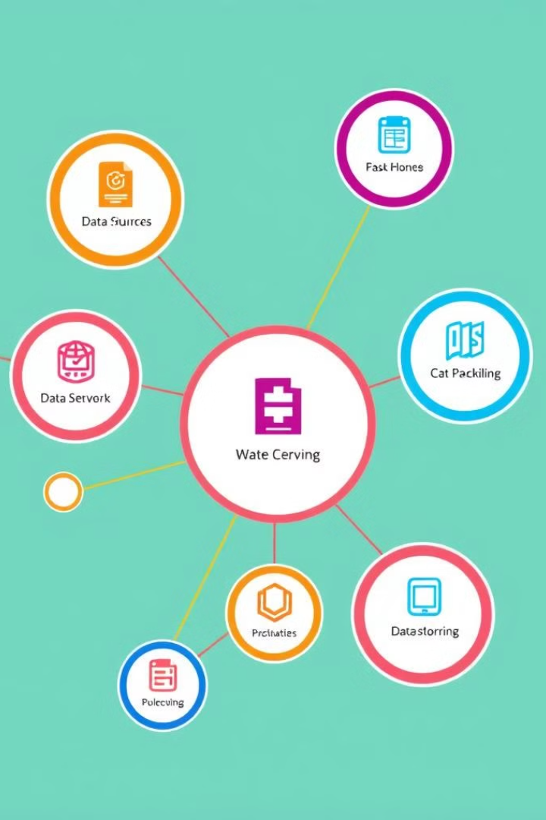

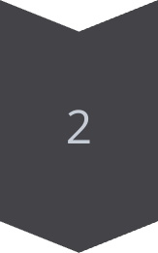

Multimodal Data Integration
Biometric Data
Wearable sensors, IoT platforms, and real-time analytics.
Genetic Profiles
Bioinformatics tools and comprehensive risk assessment.
Cognitive Assessments
Speech, language, and facial expression analysis for early detection.

Slide 10

Collaborative Development and Scalability
1
Version Control
2
Project Management
3
Scalable Infrastructure
Git and GitHub/GitLab enable seamless collaboration and version management among the development team.
Jira and Trello facilitate task tracking, roadmap planning, and coordinated progress for the platform's development.
Docker and Kubernetes ensure the platform can be scaled efficiently to meet growing user demand and data requirements.

Slide 11
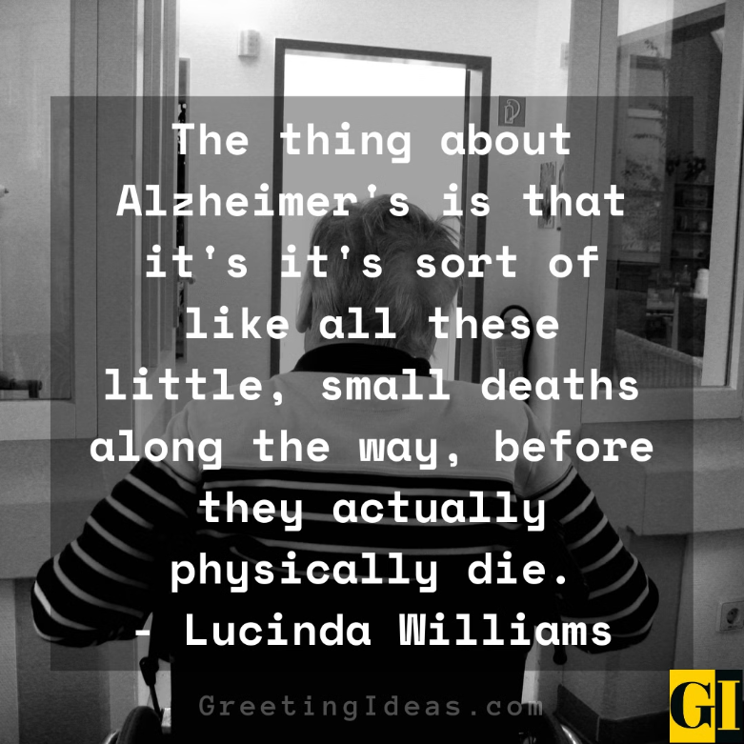
THANK YOU
"Empowering healthcare with AI-driven early detection and personalized care"
Made by: Chandan Jha Pranav R Vedaant Mitra Khushal Gupta

